Slide 1
Design Patterns

Slide 2
How I will present each design Pattern
Discuss Prerequisites of learning this pattern.
Discuss the code problems this design pattern is intended to help solve.
Define the pattern including the original Gang of Four definition and UML
Discuss how this pattern helps achieve SOLID software development principles.
Discuss real-world scenarios where you would use this design pattern.
An implementation of one of these real-world scenarios.

Slide 3
Week 2
Singelton and Factory Patterns

Slide 4
Singleton Design Pattern
Your first pattern

Slide 5
Singleton Prerequisite
IOC Container

Slide 6
What is an IOC container
An IOC container is a way to resolve dependency trees when using Dependency Inversion.
Because dependency inversion requires a lot of instantiation of classes and IOC container can help you resolve an entire dependency tree.
IOC containers allow you to register an Interface with the constructor of a concrete object then whenever a implementation is needed you resolve your dependencies and as long as all the objects are registered it will resolve the whole dependency tree.
IOC containers help a system be more open closed by relying on abstractions rather than concrete classes.
It also makes Dependency Inversion much easier.
Finally It allows singleton objects to not need static methods improving testability.

Slide 7
IOC and Singleton
We will still teach how to implement a normal singleton pattern.
IOC containers can however provide the same functionality without having to implement singleton from scratch.
The demos we will use will implement it both ways.

Slide 8
Singleton Defined

Slide 9
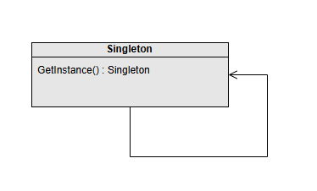
Gang of Four Definition
“Ensure a class has only one instance and provide a global point of access to it.”

Slide 10
Attributes of a singleton
A singleton is a class that controls its own instantiation.
A singleton can only create an instance of itself through a static constructor.
The first time a singleton’s constructor is invoked it creates a new instance of that class.
Subsequent invocations of the constructor return the same instance created in the first invocation.

Slide 11
Benefits of a Singelton Pattern
A singleton object is only created once (avoiding the expense of creating a class multiple times).
A singleton object always acts the same way anywhere in the system and contain the same data.
A singleton can share data across large systems.

Slide 12
Down sides of Singelton
Its default form breaks the single responsibility principle.
In multi-threaded programs singleton may react inconsistently.
Static Methods are difficult to test.
Objects can become too bloated.
Does not release memory as efficiently.

Slide 13
Relationship to Solid
Singleton

Slide 14
Singletons need help with SOLID
Some consider Singelton an Anti-Pattern (A pattern that makes things worse not better).
Because Singletons both manage their creation and their state plus do whatever the singleton object is supposed to do it technically breaks single responsibility.
Because singletons are static in nature they are difficult to pass around making it difficult to achieve Open Closed as well as Dependency Inversion.
However there is hope. With an IOC container you can implement singleton functionality while maintaining all of the solid principles. Through IOC you can have all of the upside with less of the downside.

Slide 15
Real World Scenarios

Slide 16
What are some Scenarios where Singletons Might be Useful?

Slide 17
Scenarios where Singletons are often Used
IOC containers themselves
Loggers
Configuration Management
Game State Management (Avoid the GOD class)

Slide 18
Implementation
Singelton

Slide 19
Implementing a Singelton in Code

Slide 20
Implementing a Singleton using IOC
Using Unity

Slide 21
Factory Design Pattern
Making stuff with the things

Slide 22
Factory problem space

Slide 23
What problems do factory methods Help Solve?
Not knowing what object implementations you will need ahead of time.
Implementing complex conditional logic.

Slide 24
Factory Defined

Slide 25
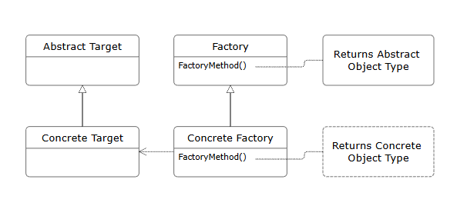
Gang of Four Definition
“Define an interface for creating an object, but let subclasses decide which class to instantiate. Factory method lets a class defer instantiation to subclasses.”

Slide 26
Attributes of a factory
Encapsulation of Object Creation : Hides the details of instantiating Objects making code more modular.
Interface – Based Design
Reusability : Allow us to reuse complex creation code across applications.
Polymorphism : Supports polymorphism by returning different subclasses of common classes.
Scalability : New types can easily be added.

Slide 27
Benefits of a Factory Pattern
Enhances Maintainability : Because it encapsulates instantiation logic so that the only place instantiation logic needs to change is in the factory.
Supports Loose Coupling : The client code depends on abstractions facilitating loose coupling.
Improves Testability : Allows mocking and ease of testing individual components.

Slide 28
Down sides of A factory
Increases the Complexity: By adding a layer of abstraction you also add complexity. (KISS) (YAGNI)
Less transparency on how objects are created and instantiated.
Reduced Performance
Factories themselves are tightly coupled to the objects they create even though they promote loose coupling in the objects themselves.

Slide 29
Relationship to Solid
Factory

Slide 30
Factory Method and S.O.L.I.D.
S. Factory promotes single responsibility by separating the creation logic from the class logic.
O. Because factories depend on abstractions extension is easier and modification though necessary in the factory itself is reduced in the implemented classes.
L. Factories control what kind of classes are created and although it doesn’t prevent violations of Liskov It does promote it.
I. Factories are based on interfaces. Again this does not prevent abuse of this principle but it does not hinder it either.
D. Factories can be used in IOC containers to instantiate objects. It actually promotes even better use of IOC containers and presents abstractions so that dependency inversion can occur. I can even act in some ways like an IoC Container by removing the complexity of many layers of dependency.

Slide 31
Real World Scenarios
Factory

Slide 32
What are some Scenarios where factories Might be Useful?

Slide 33
Scenarios where Factories are often Used
Anywhere you are working with Interfaces or Abstract classes with multiple implementations.
Decoupling Client code from specific OS or other dependencies. (Have a single application that works on both Windows and Mac where you want to take advantage of OS specific functionality)
Whenever the creation of an object is complex (IE multiple dependencies)
When selecting the instance type of a class is complex.

Slide 34
Implementation
Factory

Slide 35
Implementing a Factory in Code

Slide 36
Abstract Factory Design Pattern
Make all the stuff with the things

Slide 37
Abstract Factory problem space

Slide 38
What problems does Abstract factory Help Solve
How can I use the same single object throughout my entire application?

Slide 39
Gang of Four Definition
“An interface for creating families of related or dependent objects without specifying their concrete classes”

Slide 40
Attributes of an abstract factory
Abstract Factory: Declares creation methods for product families.
Concrete Factory: Implements creation methods.
Products: Abstract product interfaces and concrete product classes.

Slide 41
Benefits of an abstract Factory Pattern
Consistency: Ensures all objects in a family adhere to the same structure.
Flexibility: Simplifies switching between different families of objects.
Scalability: Facilitates adding new families without altering existing code.
Code Reuse: Encourages modular and reusable design by separating object creation

Slide 42
Down sides of An abstract factory
Complexity: Adds extra layers of abstraction and increases initial development effort.
Rigidity: Can be challenging to introduce new products into existing families.
Overhead: May lead to unnecessary complexity if the application doesn’t require multiple product families.

Slide 43
What are some Scenarios where abstract factories Might be Useful?

Slide 44
Scenarios where abstract Factories are often Used
IOC containers themselves
Loggers
Configuration Management
Game State Management (Avoid the GOD class)

Slide 45
Relationship to Solid
Abstract factory

Slide 46
Factory Method and S.O.L.I.D.
Single Responsibility Principle (SRP):
Encapsulates object creation within dedicated factory classes, simplifying code maintenance.
Open/Closed Principle (OCP):
Abstract factories can be extended to support new object families without modifying existing code.
Liskov Substitution Principle (LSP):
Product abstractions ensure that any derived class can replace its base class without issues.
Interface Segregation Principle (ISP):
Defines specific interfaces for product families to avoid bloated and irrelevant methods.
Dependency Inversion Principle (DIP):
High-level modules depend on abstractions, not concrete implementations, promoting flexibility.

Slide 47
Real World Scenarios
Abstract Factory

Slide 48
Implementation
Abstract Factory

Slide 49
Implementing an abstract factory in Code

Slide 50
Week 3
Case Enumeration / Commonality Variability / State Design pattern

Slide 51
Enumerating Cases
Commonality Variability Analysis and other approaches

Slide 52
Commonality Variability Analysis

Slide 53
What is Commonality Variablity Analysis

Slide 54
How do we Apply Commonality Variability Analysis
Establish the Scope
Identify Commonalities and Variabilities
Bound the Variabilities
Exploit the Commonalities
Accommodate the variabilities

Slide 55
Commonality Variability with Magic
We will be doing a commonality variability study with Magic the Gathering Cards.
Don’t worry if you don’t play magic it dosen’t matter.
People who play magic or other card games may be able to find additional commonalities and variability but that is not the point. The point is to look at what you have and do this to the best of your ability based on what is in front of you.
I will put up an anatomy of a magic card up on the board so that you can see what things mean on the cards but again finding the obvious commonalities and variability in the cards is what is important.
You will have 15 cards to start with. Apply these principles to your starting cards.
Do not worry about doing damage to these cards they will be tossed after class or you can keep them whatever.
I put sleves on them not to product them but so you can use dry erase markers to write on them and erase if you want to.

Slide 56
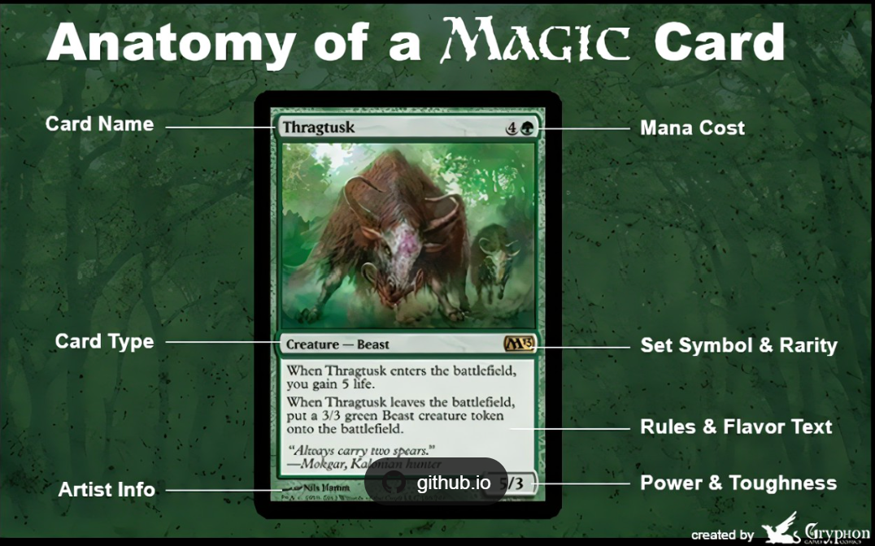

Slide 57
Initial assessment (5 Min)
Each of you has a magic card.
Look at your magic card and at the top of an index card (one card per attribute) list as many attributes as you can of the card you are looking at.

Slide 58
Establish the Scope Take 10 Min
Now as a team look at all the cards your team has.
Try and discover what the full scope of the cards you have include.
As a help magic only has 5 main colors you can see the colors represented as dots on the back of the cards.
Cards can also be colorless.
Outside of that established scope see what you can make of any other scope and looking at the cards you have eliminate any things you don’t believe are pratical changes that could be made.
Write the elements of this scope on a single index card.
ALL THE CARDS YOU HAVE MUST BE IN SCOPE. (IE none of them can break the parameters of your scope)
Determine at least 3 other things you will not allow within your scope or must exist to be included within your scope.

Slide 59
Identify Commonalities / Variablities Setup (15 MIN)
Take all the cards you created when you were doing your individual initial assesments.
Compare those cards to all the cards others created.
Throw away any duplicate attribute cards or combine similar concepts into one card.
Once you have gotten rid of extra cards come up with any additional attributes any of the cards you now know about have.
You should get more general (They all Have a color, They all have a Name)
You should also get more specific (Some cards are sorcery cards)

Slide 60
Determine what cards fit in which group (15 Min)
You may want to number each of the individual cards to make this easier.
For the next 15 min Grab a card from your pile of attributes and then go through each magic card card (It may help to have each person have a subset of cards) If that card fits into that group write the name or number of that card on your index card.
Keep doing this for each index card.
If you run out of index cards figure out if there are attributes you are missing. Make those cards and continue this activity with those cards as you make them.

Slide 61
Bound the Variabilites (10 Min)
Put your scope card front and center so everyone can see it.
For the next 10 minutes do the following
Look at the variability cards you have.
For each card as a group decide what the boundaries you want to place on that variability are.
To do this the boundries.
Can not cause you to exclude any card that do not fit in to this variability.
Must account for all the cards that do exist within this variability.
Clearly define what does and does not fix in to this variation.

Slide 62
Exploit the Commonalities (On a white board Psudeo Code)
For the next 10 minutes look at all of the commonalities your card have.
Create an interface (Or set of interfaces remember single responsibility and interface segregation) design that lists all of the properties that all the cards have in common.
Create a Card Class that inherits all of these interfaces.

Slide 63
Accommodate for the Variabilities (10 Min)

Slide 64
State Design Pattern
Making stuff with the things

Slide 65
State problem space

Slide 66
What problems does State Pattern Help Solve?
Creating a family of algorithms.

Slide 67
State Pattern Defined

Slide 68
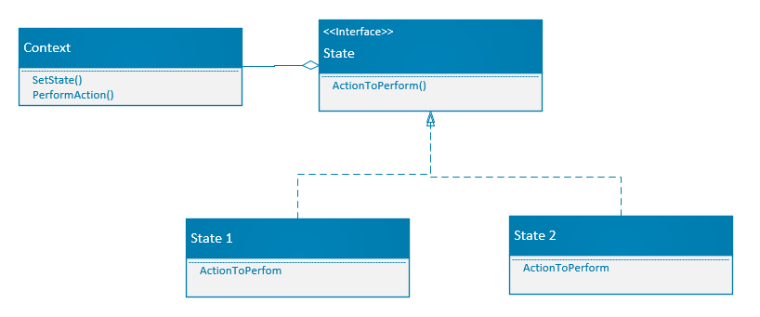
Definition
“The State Pattern allows an object to alter its behavior when its internal state changes. The object will appear to change its class.”

Slide 69
Attributes of a State Design Pattern
Context: Maintains a reference to a State object representing the current state.
State Interface/Abstract Class: Defines a common interface for all concrete states.
ConcreteState Classes: Implement state-specific behavior for each state.

Slide 70
Benefits of a State Design Pattern
Modularity: Encapsulates state-specific behavior in separate classes.
Simplicity: Eliminates large conditional statements in the Context.
Extensibility: Easy to add new states without modifying Context.
Explicit Transitions: State changes are clear and controlled.
.

Slide 71
Down sides of A State Design Pattern
Increased Classes: Each state requires a ConcreteState class.
Complexity: May overcomplicate simple state-dependent behavior.

Slide 72
Relationship to Solid
State

Slide 73
State pattern and S.O.L.I.D.
S. Each Concrete class has a single responsibility (To handle the behavior for a specific state)
O. State Pattern is open to extension (by adding new concrete classes) and closed to modification by not necessitating changing other classes to implement the new state.
L. States must be interchangeable for one another because they fully must represent their individual state.
I. The state interface requires an interface that only does what is required to handle the state and not force having nonessential functionality.
D. State can be injected into context and context is dependent on the interface not the concrete class.

Slide 74
Real World Scenarios
State pattern

Slide 75
What are some Scenarios where The State Pattern Might be Useful?

Slide 76
Scenarios where The State pattern is often Used
Use when behavior depends on state and must change dynamically.
Ideal for replacing complex state-based conditionals with polymorphism.
Vending Machines
Order Processing
Traffic Light
Game Characters

Slide 77
Implementation
State Pattern

Slide 78
Implementing a State Pattern in Code

Slide 79
Week 4
Layering/ Valuable Abstractions/ Strategy Design pattern

Slide 80
Layering
I Like Pancakes

Slide 81


Architecture Layers
Presentation Layer
Business Logic Layer
Data Access Layer
Database Layer

Slide 82
Software Design Patterns
Model – View – Controller (MVC)
Layered Architecture Pattern

Slide 83
Network Protocol Layers
Application Layer
Transport Layer
Network Layer
Data Link Layer
Physical Layer

Slide 84
Operating System Layers
User Space
Kernal Space
Hardware Abstraction Layer

Slide 85
Security Layers
Perimeter Security
Network Security
Application Security
Data Security

Slide 86
Development Process Layers
Requirement Analysis
Design
Implementation
Testing
Deployment
Maintenance

Slide 87
Virtualization Layers
Hypervisor
Guest OS Layer
Application Layer

Slide 88
Microservices Architecture
Service Layer
API Gateway Layer

Slide 89
Cloud Computing Layers
Infrastructure as a Service
Platform as a service
Software as a Service

Slide 90
Why so many Layers in Software?
Separation of Concerns
Modularity
Isolation
Maintainability
Ease of Updates
Simplified Debugging
Scalability
Reusability
Component Reuse
Service Reuse
Flexibility
Interchangeability between Layers

Slide 91
Layering and S.O.L.I.D.
S. Just like classes layers should have single responsibilities.
O. Layered code can bet extended to provide new functionality without needing to modify existing code.
L. This principle is still applicable at software layer levels.
I. Interfaces at the layer level should expose just what they need just like classes.
D. Higher layer levels should not depend on lower level layers. UI logic should not depend on business and business should not depend on data for example.

Slide 92
Using Layers throughout your Code
Create a console application.
Put all the necessary code in the console app to read some text from a text file.
Then take that text and transform it in any way you wish.
Then have it write to the console.

Slide 93
STRATEGY Design Pattern
Making stuff with the things

Slide 94
STRATEGY problem space

Slide 95
What problems does STRATEGY Pattern Help Solve?
Implementing Complex Business Logic
Creating a family of related algorithms

Slide 96
Strategy Pattern Defined

Slide 97
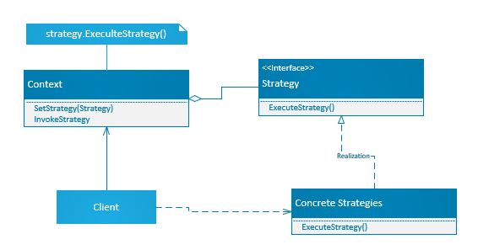
Gang of Four Definition
“Define a family of algorithms encapsulate each one and make them interchangeable. Strategy lets the algorithm vary independently from clients that use it.”

Slide 98
Attributes of a Strategy Design Pattern
There is a strategy interface the defines the action method.
Multiple concrete strategies (Implementations)
There is a strategy context which encapsulates the strategy interface
The context allows the calling code to set its internal strategy field to a concrete implementation
The concrete strategy implementation is set on the context based on some conditional logic

Slide 99
Benefits of a Strategy Design Pattern
Reduces complex conditional logic from the code because each type of behavior is handled by it’s own strategy
Easily swap algorithms at runtime
Because the context retains I’s strategy you don’t have to execute conditional logic regularly
.

Slide 100
Down sides of A State Design Pattern
Most languages provide method delegation and in many cases this may be a more appropriate implementation to solve this problem.
May overcomplicate behavior.

Slide 101
Relationship to Solid
State

Slide 102
Strategy pattern and S.O.L.I.D.
S. Each Concrete class has a single responsibility (To handle the behavior for a specific strategy)
O. Strategy Pattern is open to extension (by adding new concrete classes) and closed to modification by not necessitating changing other classes to implement the new strategy.
L. Concrete Strategies must be interchangeable for one another because they fully must represent the strategy interface.
I. The Strategy interface requires an interface that only does what is required to handle the strategy involved and not force having nonessential functionality.
D. The strategy can be injected into context and context is dependent on the interface not the concrete class.

Slide 103
Real World Scenarios
Strategy pattern

Slide 104
What are some Scenarios where The Strategy Pattern Might be Useful?

Slide 105
Scenarios where The State pattern is often Used
Payment Processing Systems
Data Encryption
Sorting
File Compression
Authentication

Slide 106
Haven’t I seen this somewhere before?
This is just a state pattern right?

Slide 107
Difference between State and Strategy
State
Strategy
Changes the object’s behavior based on its internal state.
Varies based on when the state of the application changes.
Concrete classes represent a full state.
Changes based on client selection.
Varies when choosing a specific strategy at a specific time in execution.
Concrete classes represent a different strategy for solving a problem.

Slide 108
Implementation
Strategy Pattern

Slide 109
Implementing a Strategy Pattern in Code

Slide 110
Gang of Four Definition
“Ensure a class has only one instance and provide a global point of access to it.”

Slide 111
Gang of Four Definition
“Ensure a class has only one instance and provide a global point of access to it.”

Slide 112
Gang of Four Definition
“Ensure a class has only one instance and provide a global point of access to it.”

Slide 113
Gang of Four Definition
“Ensure a class has only one instance and provide a global point of access to it.”

